Slide 1


AIBridge
Lecture 6
Notes:
Going over last week’s lab
How to improve results
prepare to discuss lab 4 key

Slide 2
Let’s talk about the last lab!
Notes:
Let’s first start by reviewing last week’s lab.

Slide 3
What circumstances made the model fit better?
Let’s talk about the last lab!
what does this even mean?
worse?
Notes:
There were some changes you could have made that would make your model better, (click) and some that would make it worse.
But first, (click) what does a better model even mean? I guess you could say a better model is one where the loss keeps going down, but loss is a bit of an abstract quantity. it’s hard to intuitively get a sense of what loss represents.
For example, if you think back to last week’s classes, (click) we mentioned that one way to measure loss is through the squared sum of all the distances from each point to the line. I don’t know about you but that’s pretty hard for me to visualize.

Slide 4
Accuracy
“Why is it not enough?”
Notes:
So, there should be some way to easily and intuitively measure how good a model is performing. Something called accuracy is fairly common, and you’ve probably seen accuracy show up in, say a covid test.
But there’s also these other two ways that I want to mention. (click) Precision and recall. Now, there’s always the assumption that accuracy is good enough to quantify everything, but I hope I can convince you otherwise today in this lecture.
Let’s begin by exploring each of these 3 metrics.

Slide 5
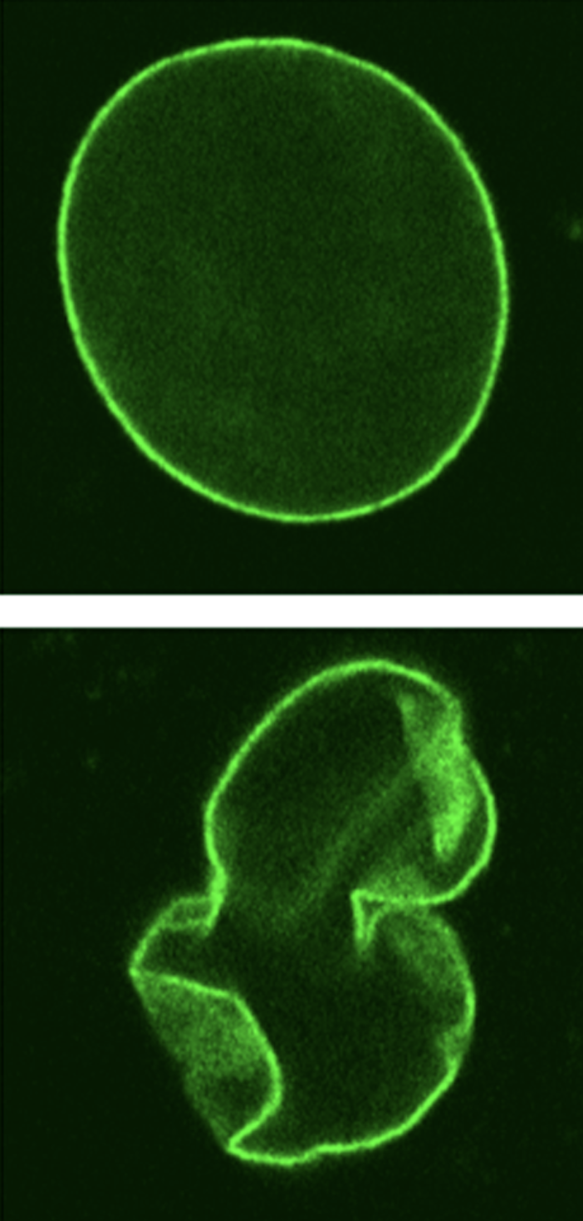
Progeria affects ~159 patients in the US
we have a dataset of all American pediatric patients
Q: If my model predicts with 99.99% accuracy, is it good enough?
Notes:
Progeria is an extremely rare disease that affects just over a hundred patients in the US. Progeria can be identified by the deformed nucleus within a cell. So, (click) let’s say we have a dataset of ALL the hundreds of millions of American pediatric patients…

Slide 6
protein shape
Model
progeria
(yes or no)
Progeria affects ~159 patients in the US
we have a dataset of all American pediatric patients
Notes:
We want to determine if any of the hundreds of millions of patients have progeria, so, we make a model that predict, either yes or no, whether a patient has progeria.

Slide 7

a proposed model:
Model
no progeria regardless
protein shape
actually pretty accurate!
Progeria affects ~159 patients in the US
we have a dataset of all American pediatric patients
Notes:
Now, let me propose a hypothetical model. Lets say, in this model, we take in all the data for one patient, including the nucleus structure, height, allergies, and all other biometrics. And, instead of doing some heavy computations, we just always output (click) no. No progeria. This seems strange, that’s a horrible model. And you would be correct, it doesn’t do anything. However, when we calculate its accuracy, (click) it’s nearly 100%.

Slide 8
Accuracy
, Precision, and Recall
Notes:
So, there should be some way to easily and intuitively measure how good a model is performing. Something called accuracy is fairly common, and you’ve probably seen accuracy show up in, say a covid test.
But there’s also these other two ways that I want to mention. (click) Precision and recall. Now, there’s always the assumption that accuracy is good enough to quantify everything, but I hope I can convince you otherwise today in this lecture.
Let’s begin by exploring each of these 3 metrics.

Slide 9
“Selection space”
Notes:
So here (click) is a funny little shape. Let’s call it the selection space (click).
This entire rectangle represents all of the results our model gives us.
Let me give an example. Let’s say our model has to predict whether or not a person has covid. Yes or no, so this is classification. This entire rectangle represents all the decisions our models makes, positive or negative, on the patients that we run through the model.
First, we start with the small light green triangle. Here, the small green triangle represents…

Slide 10
“Selection space”
Notes:
So here (click) is a funny little shape. Let’s call it the selection space (click). Some of you might be very familiar with this concept, although called differently, which I will connect later. If so, feel free to zoom out a bit. This is really important stuff here, so we will need to cover it.
This entire rectangle represents all of the results our model gives us.
Let me give an example. Let’s say our model has to predict whether or not a person has covid. Yes or no, so this is classification. This entire rectangle represents all the decisions our models makes, positive or negative, on the patients that we run through the model.
First, we start with the small light green triangle. Here, the small green triangle represents…

Slide 11
Model selects positive and patient is positive
“Selection space”
Notes:
…all the cases when our model classifies a patient as positive and the patient is indeed positive. So light green triangle is when our model did its job correctly.
The small light red section…

Slide 12
Model selects positive and patient is positive
Model selects positive and patient is negative
“Selection space”
Notes:
…represents all the times where our model classifies a patient as positive and the patient is actually negative. So light red triangle is when our model did its job incorrectly.
Next up is the big dark green shape,…

Slide 13
Model selects negative and patient is negative
Model selects positive and patient is positive
Model selects positive and patient is negative
“Selection space”
Notes:
…which represents cases where our model classifies a patient as negative and the patient is indeed negative. So a big dark green shape is when our model did its job correctly.
Lastly, the big dark red shape…

Slide 14
TRUE POSITIVE
FALSE NEGATIVE
FN: Model selects negative and patient is positive
TP: Model selects positive and patient is positive
FALSE POSITIVE
TRUE NEGATIVE
FP: Model selects positive and patient is negative
TN: Model selects negative and patient is negative
“Selection space”
Notes:
Ok great! Let’s now tackle precision. (Click)

Slide 15
“Number of cases where we chose positive when patient is positive
and
Number of cases where we chose negative when patient is negative”
Accuracy
Overall ability of model
“Everything”
Notes:
Accuracy is, (click, read), (click, read.)
Meaning, it is the measure of the overall ability of our model — the number of cases where it was correct divided by the total number of cases, TAKE QUESTIONS (click.)
You may be able to spot a potential issue already, which is that this equation is a bit naive. It sidesteps a lot of the complexity of the classification by only worrying about big picture information.
But don’t get me wrong, accuracy has plenty of use cases. For example, in last week’s lab, the accuracy number is actually what we got from using classifier.score

Slide 16
FN: Model selects negative and patient is positive
TP: Model selects positive and patient is positive
FP: Model selects positive and patient is negative
TN: Model selects negative and patient is negative
“Selection space”
Accuracy
Overall ability of model
Notes:
Ok great! Let’s now tackle precision. (Click)

Slide 17
“Number of cases where we chose positive when patient is positive”
Precision
Accuracy of what we selected.
Or amount of selection that’s actually correct.
“All selected positive by the model”
Notes:
In the case of precision, we have, (click, read), (click, read.)
Meaning, it is the measure of the, well, preciseness of the model. (click)
Notice how all the terms here are triangles. Triangles represent times when our model selects positive. Essentially, this equation boils down to: “when we select positive, how often is that correct?” TAKE QUESTIONS

Slide 18
FN: Model selects negative and patient is positive
TP: Model selects positive and patient is positive
FP: Model selects positive and patient is negative
TN: Model selects negative and patient is negative
“Selection space”
Precision
Accuracy
Amount of selection that’s actually correct.
Overall ability of model
Notes:
Ok great! Let’s now tackle precision. (Click)

Slide 19
“Number of cases where we chose positive when patient is positive”
Recall
Accuracy of what we should select.
Or amount of what needs to be selected that is selected
“All cases that the patients are positive”
Notes:
For recall, it is (click, read), (click, read).
This is a measure of how much of what we need to select is actually selected. (click)
That probably didn’t make sense, let me explain a bit more. The pattern here is slightly harder to spot: its that all the shapes involved in this equation represent cases where the patient is positive.
Recall essentially boils down to “when there’s a patient that’s positive, how often can we recognize it?”
TAKE QUESTIONS (click)

Slide 20
FN: Model selects negative and patient is positive
TP: Model selects positive and patient is positive
FP: Model selects positive and patient is negative
TN: Model selects negative and patient is negative
“Selection space”
Precision
Recall
Accuracy
Amount of selection that’s actually correct.
Amount of what needs to be selected that is selected
Overall ability of model
Notes:
So, let’s summarize. Accuracy is the overall ability of the model. Precision is the amount of the selection that’s actually correct. Recall is the amount of what needs to be selected that’s actually selected. TAKE QUESTIONS. (click).
TRANSITION SLIDE NO TOUCHIE

Slide 21
TRUE POSITIVE
FALSE NEGATIVE
FALSE POSITIVE
TRUE NEGATIVE
Accuracy
Precision
Recall
Amount of selection that’s actually correct.
Amount of what needs to be selected that is selected
Overall ability of model
Notes:
Alright, so all those fractions with triangles and notched rectangles we just covered do actually translate over into actual equations, and here they are.
The green triangle represents true positives (click), the red triangle represents false positives (click), the green rectangle represents a true negative (click), and the red rectangle represents a false negative(click).

Slide 22
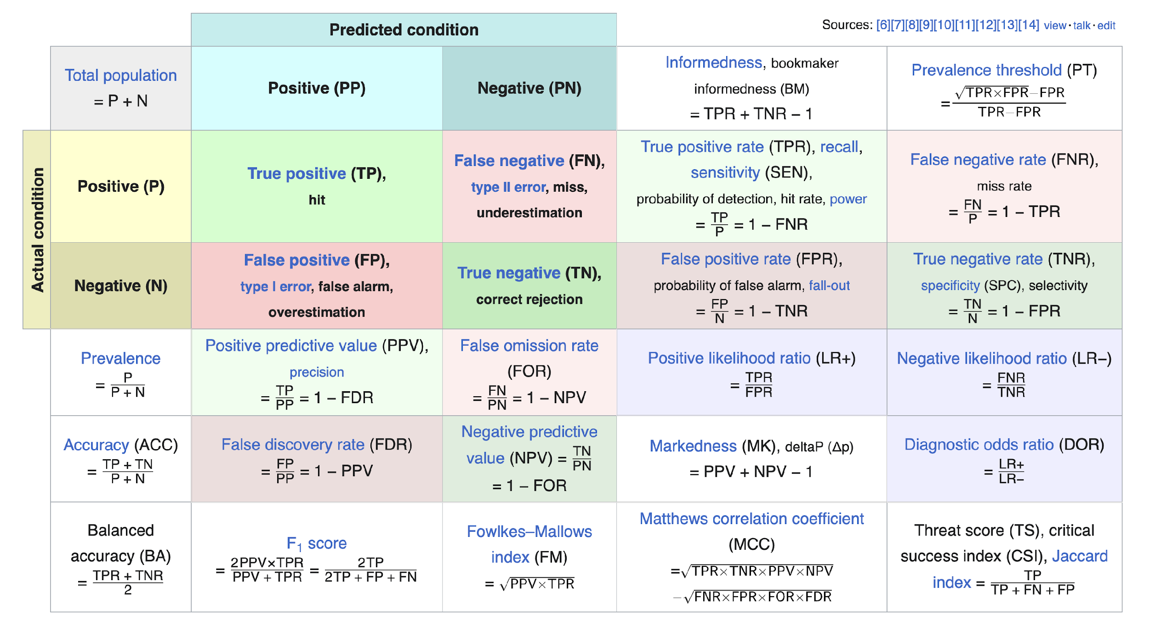
https://en.wikipedia.org/wiki/Precision_and_recall
Notes:
We are

Slide 23
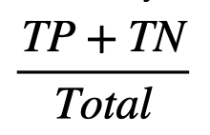
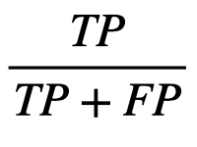
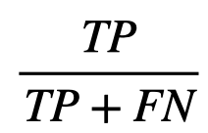

Accuracy
Overall ability of model
exactly zero
Model
no progeria regardless
Precision
Amount of selection that’s actually correct.
Progeria affects ~159 patients in the US
Recall
we have a dataset of all American pediatric patients
Amount of what needs to be selected that is selected
scaled properly!
Notes:
Lets think back to those three equations we talked about earlier. The number of true positives in this case would be (click) exactly zero since our model never chooses yes. However, the number of true negatives is in the hundreds of millions. These are the patients that don’t have progeria that our model correctly identified as not having progeria. In this case here, we see that our accuracy will be basically equal to 1, or 100%, despite having a completely useless model. Instead, what we should have used is recall (click), which takes the number of true positives, which is zero in this case, and divides it by the number of true positives and false negatives. The recall of our model is, 0%, which is a much better representation of this hypothetical model.
* in different cases, you should use different metrics

Slide 24
storytime!
Notes:
transition over to prof. liu

Slide 25
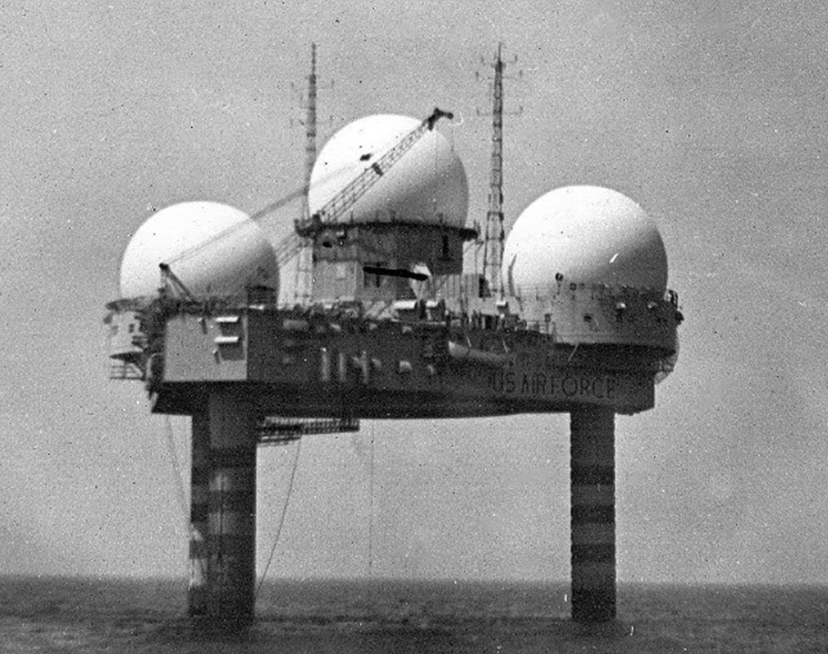
storytime!

Slide 26
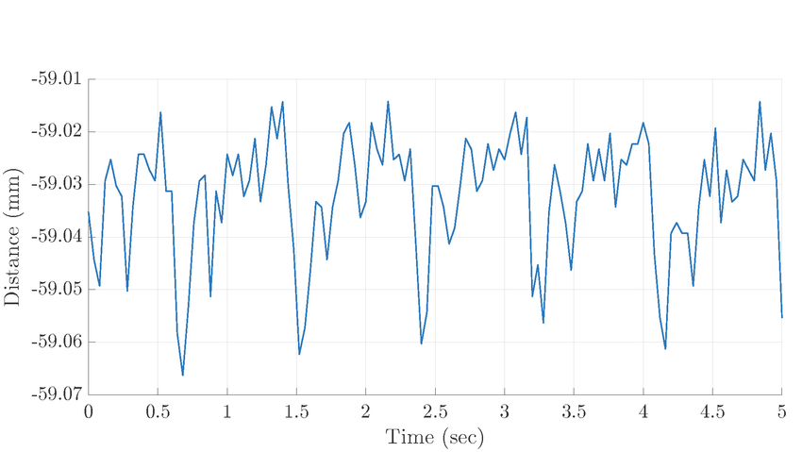

storytime!
does this count as detection?
Notes:
Radar technology started in WWII, During its early development in WWII, radar played a pivotal role in detecting and intercepting enemy aircraft, greatly improving the effectiveness of air defense systems. Radar detects aircraft by emitting radio waves that bounce off the aircraft and return to the radar antenna, allowing the radar to determine the location, speed, and direction of the aircraft.

Slide 27
storytime!
“threshold”
high recall, low precision
Notes:
What about precision recall if my threshold is here?
why is it that high recall no precision?

Slide 28
storytime!
“threshold”
high precision, low recall
Notes:
What about this case?

Slide 29
quantifying
“threshold”
Notes:
why

Slide 30
quantifying
ROC Curve!
“threshold”
Notes:
why

Slide 31

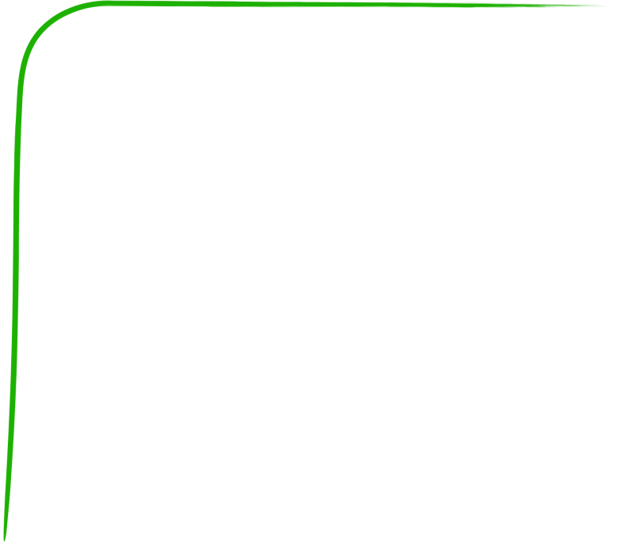

Great!
“Random”
ROC Curve!
True Positive
Receiver Operation Curve
Q: How is a curve generated?
need lots of false positives before detecting a true positive
Awful.
False Positive
ROC Curve quantify the amount of “error”/noise that is necessary for a classifier to make a good prediction
Notes:
it stands for reciever operation curve, which I think is super cool. How do we get this

Slide 32
Great!
True Positive
AUC
area under [the ROC] curve
Q: how do you compare these points
False Positive
Notes:
AUC is one number that evaluates how your models work under different thresholds. IN other words, it condenses information to one number. In such cases, almost always we will lose some information at the benfit of convenience.

Slide 33
Self-test
Precision–recall AUC
Precision
Q: When do we really need it?
Q: what would it look like?
Especially for unbalanced datasets
Recall
Notes:
Take questions, transition back to Jiaming’s section.

Slide 34
more data
what makes models fit better
balanced data
normalized data
quality data
Notes:
Ok, so after all this, what actually makes a model fit better? It all has to do with data. There’s a common principle in computer science: garbage in, garbage out. If you don’t have good inputs, then you shouldn’t expect your outputs to be any good either. You can get better inputs by (click) adding more data, (click) balancing your data, (click) or normalizing your data.

Slide 35
more data
balanced data
normalized data
quality data
Notes:
(click) Let’s focus first on adding more data (click).

Slide 36
more data
balanced data
normalized data
quality data
Notes:
(click) Let’s focus first on adding more data (click).
if data isn’t perfect: small # of datapoints=more fluctuation, more datapoint s=less fluctuation

Slide 37
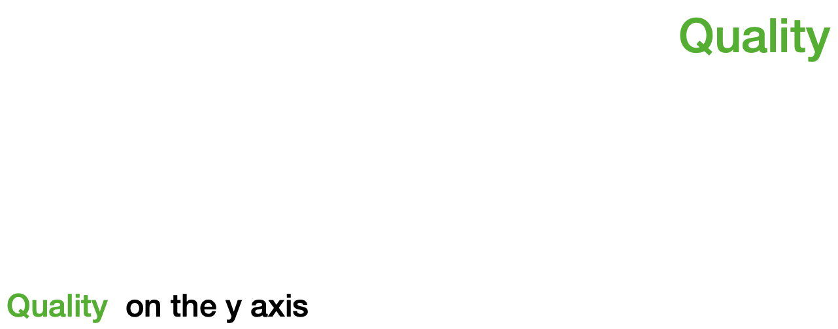
more data
let’s say we have a simpler wine dataset
Acidity on the x axis
Acidity
Notes:
Let’s think back to the wine dataset, and for simplicity sake we only consider two things:
(click) Wine Quality, which we will graph on the y-axis. Remember, this is what our model is trying to predict.
(click) Wine Acidity, which we will graph on the x-axis. This is what our model will take in as input.
If we try to train our model with only, let’s say 3 datapoints, it won’t perform particularly well for various reasons.

Slide 38
more data
Acidity on the x axis
Notes:
Maybe the few data points we used for training happened to be outliers or maybe their data is inaccurate like this example demonstrates. Then the result will be a model that is completely unusable.
- The relationship between features and the number of needed data samples

Slide 39
more data
Acidity on the x axis
Notes:
TRANSITION SLIDE

Slide 40
more data
Acidity on the x axis
Notes:
Or maybe the few points that were used don’t tell the whole story about the dataset. The result here is that the model doesn’t generalize to the underlying trend of a set of data.

Slide 41
more data
Acidity on the x axis
Notes:
So how do you fix not having enough data? Well, simply add more data. (click) So long as the data is collected and used consistently, adding more data for your model to train on will generally improve its performance.
Connect having more data is also related to reducing variance (as discussed in debugging lecture).

Slide 42
more data
Acidity on the x axis
use more data, get more accurate results
Notes:
So how do you fix not having enough data? Well, … simply add more data. (click) So long as the data is collected and used consistently, adding more data for your model to train on will generally improve its performance. (click)
One extra thing to note is that you don’t always have to go out and collect more data to increase the amount of data. There is a technique called Data Augmentation where you can adjust already existing samples of data to generate additional samples. For example, if your dataset has images, maybe you adjust the contrast or saturation of the image or flip the image horizontally or maybe crop off an edge of the image. However, this isn’t really possible for the dataset’s we’re using.

Slide 43
more data
balanced data
normalized data
quality data
Notes:
More data is not only more datapoints. It has another meaning. Can anyone think of it? Let’s take a look at the next slide.

Slide 44
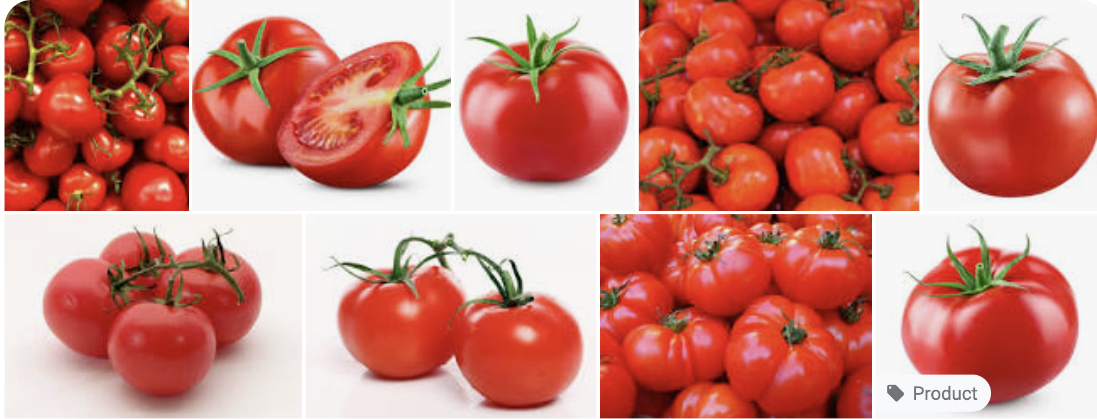
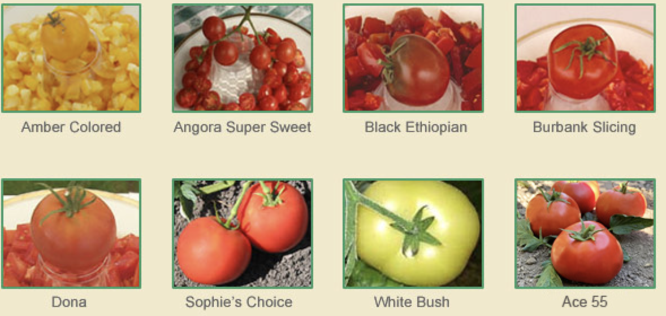
Notes:
more also have a meaning of diverse. So it generalizes better. Talk about generalization.

Slide 45
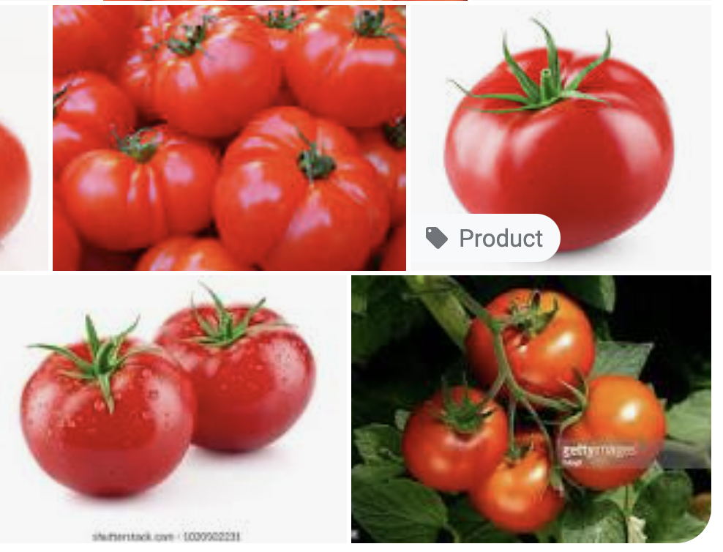
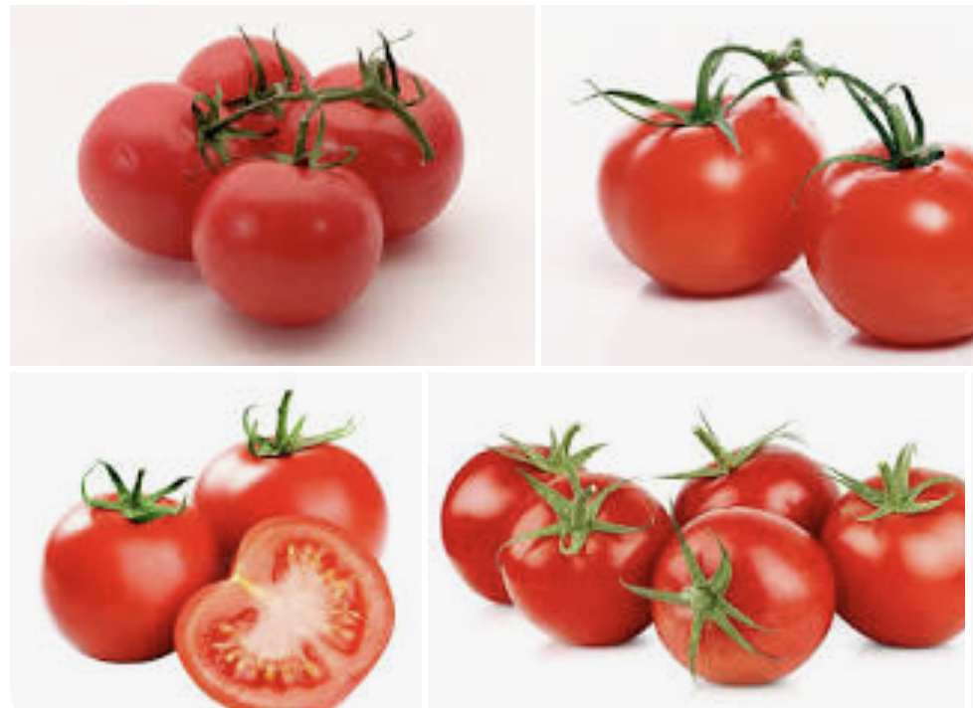
Notes:
Also means different background, different lighting conditions (especially for image classification).

Slide 46
more data
balanced data
normalized data
quality data
Notes:
(click) Let’s focus first on adding more data (click).
if data isn’t perfect: small # of datapoints=more fluctuation, more datapoint s=less fluctuation

Slide 47

more data
that’s linear(ish)*
Model
a reminder…
models are functions
Notes:
(click) As a quick reminder, (click) models are R n to R m functions. N inputs, N outputs.

Slide 48
more data
Quality
that’s linear(ish)*
Acidity
Notes:
*change graphics, remove box

Slide 49
more data
Quality
??? still not super well described
Acidity
Notes:
*show line wiggling

Slide 50
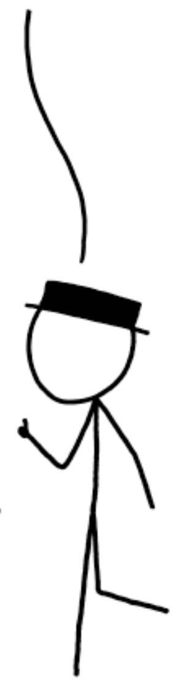
more data
Quality
But, can we formalize it?
much better!
Acidity
Notes:
* more data, the more likely our model will generalize to the data

Slide 51

more data
Quality
kind of a random variable!
Acidity

Slide 52
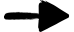
more data
Quality
wait… this is a t-test!
Acidity

Slide 53
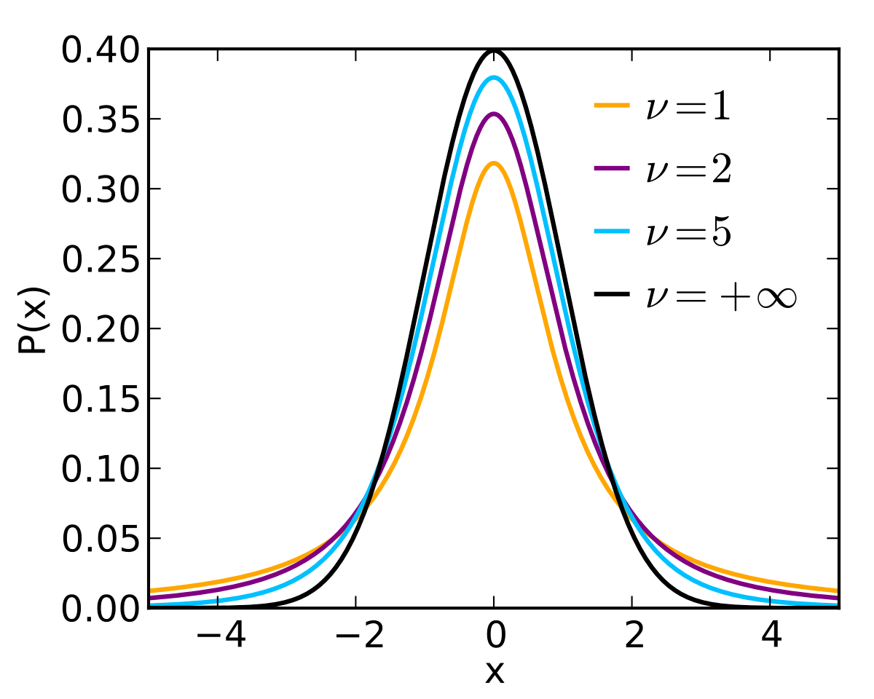

more data
Quality
Acidity

Slide 54

more data
Quality
Acidity

Slide 55

more data
Quality
Acidity

Slide 56

more data
Quality
Acidity
increased degrees-of-freedom increases the probability of the population equaling sample

Slide 57
more data
Quality
Acidity
increased degrees-of-freedom increases the probability of the population equaling sample
more data, better line
Notes:
We have some statistical assumption here!
We are assuming that our data is uniformly, randomly drawn
IF we meet for conditions for inference, this works. If NOT, we will address this more during data bias lecture in the end.
E.g. davis weather can’t predict global weather

Slide 58
more data
balanced data
normalized data
quality data
Notes:
(click) Let’s focus first on adding more data (click).
if data isn’t perfect: small # of datapoints=more fluctuation, more datapoint s=less fluctuation

Slide 59
Let’s think about logistic functions!
balanced data
Notes:
(click) and a bit of logistic functions (click).

Slide 60
Let’s think about logistic functions!
balanced data
White
Red
in an ideal world
…but no
Notes:
In an ideal world (click), we would have a perfectly even balance of data. For the wine dataset, it would be exactly 50% white wine and 50% red wine. Unfortunately (click), we don’t live in a perfect world (click).

Slide 61
Let’s think about logistic functions!
balanced data
4898
1599
White
Red
What happens when we fit this dataset entirely?
Notes:
In reality, the dataset looks something like this.
(click) 5000 samples of white wine,
(click) but only 1600 samples of red wine.
(click) so, what are the consequences of this uneven split? Let’s see what happens when a logistical model tries to fit this dataset.

Slide 62

Let’s think about logistic functions!
balanced data
Red
White
pretty well defined!
Acidity
Notes:
(click) {line 1}
(click) {line 2}
(click) {line 3}
In this exaggerated picture, we have 3 possible ways a model can conceivably fit this dataset. In the bottom left here,
(click) you see there’s a lot of data points representing white wine, so the line is pretty well defined here. Visually, this means all the lines are closer together.

Slide 63

Let’s think about logistic functions!
balanced data
Red
much more divergent
White
pretty well defined!
Acidity
balanced data, more accurate results
Notes:
In the top right however, you can see that the lines are a lot more divergent.
(click) You can think of this from the model’s perspective, it wants to minimize the total distances to every point. So, the easiest way for it to decrease the total distances is to bend more around the white wine data where more of the points are, and it can care less about the red wine because there’s less points.
(click) In general, the more balanced your data is, the more accurate your model will be.

Slide 64
more data
balanced data
normalized data
quality data
Notes:
(click) Let’s focus first on adding more data (click).
if data isn’t perfect: small # of datapoints=more fluctuation, more datapoint s=less fluctuation
How to deal with imbalanced data?

Slide 65
more data
balanced data
normalized data
quality data
Notes:
(click) Let’s focus first on adding more data (click).
if data isn’t perfect: small # of datapoints=more fluctuation, more datapoint s=less fluctuation

Slide 66
normalized data
Acidity
120
90
60
30
Sulfur Dioxide
30
60
90
120
Notes:
Here’s another hypothetical dataset. We have the Sulfur Dioxide of the wine on the x-axis and the quality of the wine on the y-axis. There are two classes of wine here, red and wine, each labeled with its corresponding color.
The goal here is a bit different from the normal regression problem. Here we want to fit a line that best separates the two classes.
We can see that the numbers for residual sugar are a lot larger than that for wine quality: Wine acidity only goes up to a maximum of 10 while residual sugar can go up to about 120.
There’s a problem here, and it may not be obvious at first, but it’s important. To demonstrate, let’s once again try to fit this data with a line that best separates the two classes.

Slide 67
normalized data
Acidity
120
x - 10y > 50
True == Red
False == White
???
90
60
30
Sulfur Dioxide
30
60
90
120
Notes:
And here’s what the separation line looks like.
Ok, nothing terrible right?
But let’s get the equation of that line (click), and here’s where problems start happening.
It looks something like this. That constant for y is 3, which is disproportionately large in comparison to the constant of x, which is just 1. This basically means that Acidity has a larger impact on the output of the model simply because its numbers have a larger range.
This may be fine when we only have 2 variables, but as we add even more dimensions, the Acidity value is going to drown out the values of any other input we add.
So how do we solve this? Once again, it has to do with our data. We need to re-distribute our data but instead using a smaller range of numbers. Let’s say we want all our data to be distributed between 0 and 1. (click)

Slide 68
normalized data
Acidity
120
90
60
30
Sulfur Dioxide
30
60
90
120
Notes:
Once again, it has to do with our data. We need to re-distribute our data but instead using a smaller range of numbers. Let’s say we want all our data to be distributed between 0 and 1. (click)

Slide 69
normalized data
Acidity
1.2x - y > 0.3
1.00
much better
0.75
0.50
0.25
Sulfur Dioxide
0.25
0.50
0.75
1.00
normalized data, better generalization, faster convergence
Notes:
As we scale all the data to the desired range, notice how that the trend in the data remains the same. We aren’t drastically altering our data, just scaling them by a certain amount. And let’s see what our line and its equation looks like now. (click) (click)
And its constants look a lot better! (click)
This process of scaling data is called normalization. (click) When working with normalized data, models can more easily generalize to patterns.

Slide 70
normalized data
Champagne
Red
White
Acidity
??? how to fit a line
Notes:
…which tends to be a lot more acidic than both red and white wine.
So this presents a pretty big problem,
(click) how are we supposed to fit this???
We could do something like this,
(click) but it completely misses the red wine data.

Slide 71
normalized data
Champagne
Red
White
Acidity
??? how to fit a line
Notes:
Or something like this, which completely misses the champagne,

Slide 72
normalized data
Champagne
Red
White
Acidity
??? how to fit a line
Notes:
This misses the white wine

Slide 73
normalized data
Champagne
Red
White
Acidity
??? how to fit a line
Notes:
And this is a compromise between all of those lines but doesn’t represent any of the data particularly well.

Slide 74
normalized data
Champagne
Red
White
Acidity
non-normalized data is hard to fit
Notes:
So what I’m trying to show here is that,
(click) when you have datapoints that are not close to each other, also known as non-normalized data, it’s hard to fit it well with a model.
Of course, there’s a solution. Since our problem is that the data is too far away from each other, we can just, squeeze them together.

Slide 75
normalized data
Champagne
Red
White
Acidity
ensure all features are internally normalized (same order of mag.)
Notes:
This is called normalization. It involves a lot of statistics and stuff about distributions and that’s out of scope, but here’s the general idea.
(click) In this normalized graph, the champagne is still more acidic than the red and white wine and the red wine is more acidic than the white wine as it was in the previous graph. However, here the data points as a whole are a lot closer together.
(click) Now it’s relatively easier to draw a good line representing the entire dataset.

Slide 76
more data
balanced data
normalized data
quality data
Notes:
(click) Let’s focus first on adding more data (click).
if data isn’t perfect: small # of datapoints=more fluctuation, more datapoint s=less fluctuation

Slide 77
more data
balanced data
normalized data
quality data
Notes:
(click) Let’s focus first on adding more data (click).
if data isn’t perfect: small # of datapoints=more fluctuation, more datapoint s=less fluctuation

Slide 78
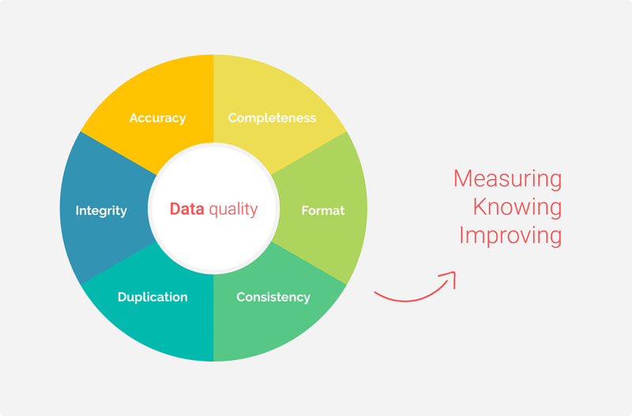
Image credit: Passionned Group

Slide 79
more data
balanced data
normalized data
quality data
Notes:
(click) Let’s focus first on adding more data (click).
if data isn’t perfect: small # of datapoints=more fluctuation, more datapoint s=less fluctuation

Slide 80
Missing Data

Slide 81
Missing completely at random
Missing Data
Missing at random
Missing not at random
Notes:
There are three types of missing data.
MAR: Definition: The probability of a data point being missing is related to the observed data but not the missing data itself.Implication: The missingness can be explained by other observed variables in the dataset.Example: In a medical study, younger patients might be less likely to report their income, but given their age, the missingness of income is random.
MNAR: Missing Not at Random (MNAR)
Definition: The probability of a data point being missing is related to the missing data itself.
Implication: The missingness is systematic and depends on unobserved data, which can lead to biased analyses if not properly addressed.
Example: People with higher incomes are less likely to report their income on a survey, and this missingness cannot be fully explained by other variables.
The second and third cases, we have to take care of them more carefully. Usually with domain knowledge.

Slide 82
remove
Missing Data
Use mean/most often
Regression
KNN

Slide 83
Which of the following methods can be used to balance an imbalanced dataset?
a) Standardization b) Data augmentation c) Cross-validation d) Feature selection

Slide 84
What does data normalization aim to achieve in a dataset?
a) To increase the dataset size b) To adjust the values to a common scale without distorting differences in the ranges of values c) To encode categorical variables d) To remove outliers from the data

Slide 85
Why is high-quality data important in machine learning?
a) It reduces the need for model evaluation b) It ensures the model performs well only on the training data c) It reduces noise and potential errors, leading to better model performance d) It increases the complexity of the model

Slide 86
In the context of machine learning, what is one way to handle missing data to maintain high data quality?
a) Increase the size of the dataset b) Remove all features with any missing values c) Use imputation methods to fill in the missing values d) Ignore the missing values and proceed with training
Notes:
c)

Slide 87
Why is having more data generally beneficial for a machine learning model?
a) It always increases the model's complexity b) It reduces the risk of overfitting c) It allows the model to learn better patterns and generalize well d) It makes the training process faster
Notes:
Both b) and c)

Slide 88
more data
balanced data
normalized data
let’s clean some data!
Notes:
More Data: adding more data to your dataset to get a more accurate model
Balanced Data: making sure there’s even amounts of each type of data to get a more accurate model.
Normalized Data: making sure all your data points have values close to one another to get a more accurate model.
Now then, (click) let’s move on to with the lab

